Slide 1
Playlist: OOP in C++ - Object Oriented Programming Channel: MyLegacy in Programming (Eman)
Class Relations
Composition - Aggregation - Association
Eman Hosam

Slide 2
Agenda
Logical Meaning
Class Relations: Single Variable
Class Relations: Array Variable

Slide 3
Logical Meaning
Class Relations

Slide 4
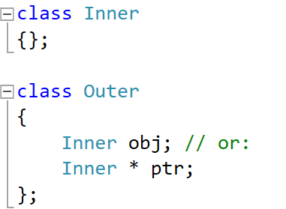
Logical Meaning of Class Relations
Composition: (has-a relationship)
When the outer class object is destructed, the inner class object must be destructed (automatic/static allocation inside the outer class)
Very Strong Relationship (Example: Car and CarBody)
Aggregation: (has-a relationship)
When the outer class object is destructed, the inner class object may be destructed (dynamic allocation inside the outer class)
Strong Relationship (Example: Car and Wheel)
Association: (uses relationship)
When the outer object is destructed, the inner class object is not affected. (no allocation inside the outer class)
Weak Relationship (Example: Car and Driver)

Slide 5
Single Variable
Class Relations

Slide 6
Order of Construction/Destruction
Order of Construction of class X:
Data members of X (in order)
Constructor of Class X itself
Order of Destruction of class X:
Destructor of Class X itself
Data members of X (reverse order)
Notes:
Pointers do NOT call constructors or destructors
Constructors are called: X x1; or new X;
Destructors are called: } or delete pX;
Note: the above order of construction or destruction is the order of body execution not calling.
Obj
Data-member1
Data-member 2

Slide 7
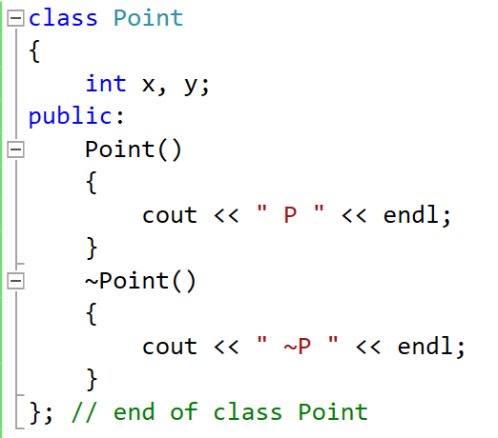
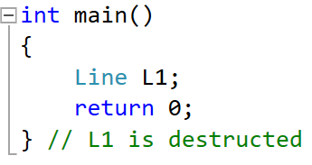
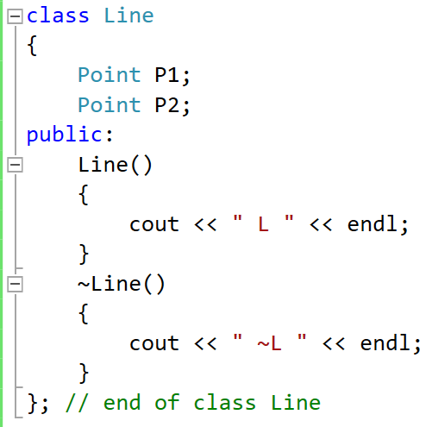
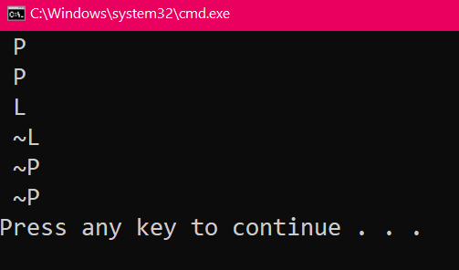
Composition
Line Obj
L1
Point Objs
3
P1
x
y
3
P2
x
y
2
2
1
4
1

Slide 8
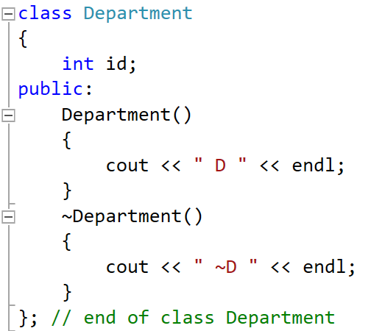
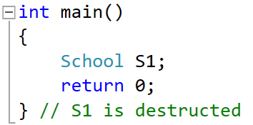
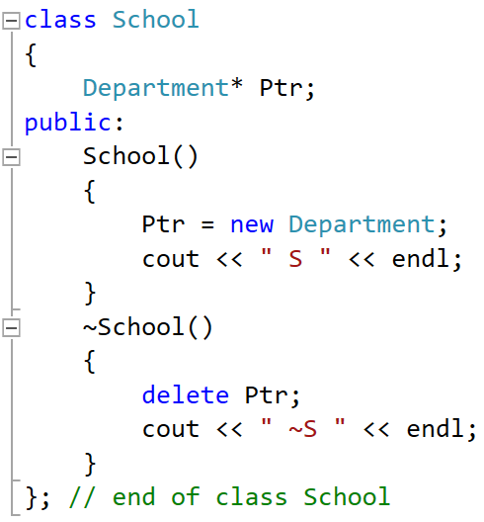
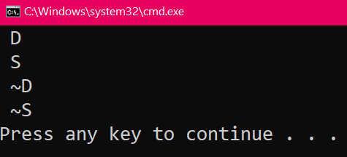
Aggregation
School Obj
4
Dep Obj
S1
Dep Ptr
2
Ptr
id
Heap
2
4
1
3
5
1
3

Slide 9
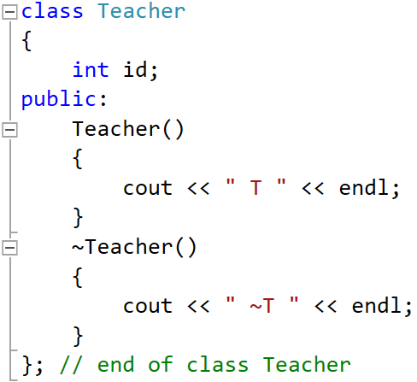
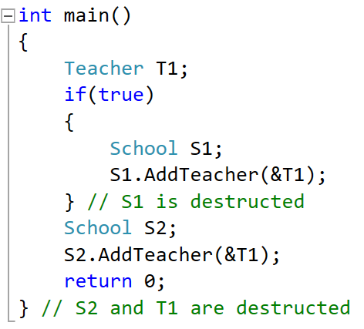
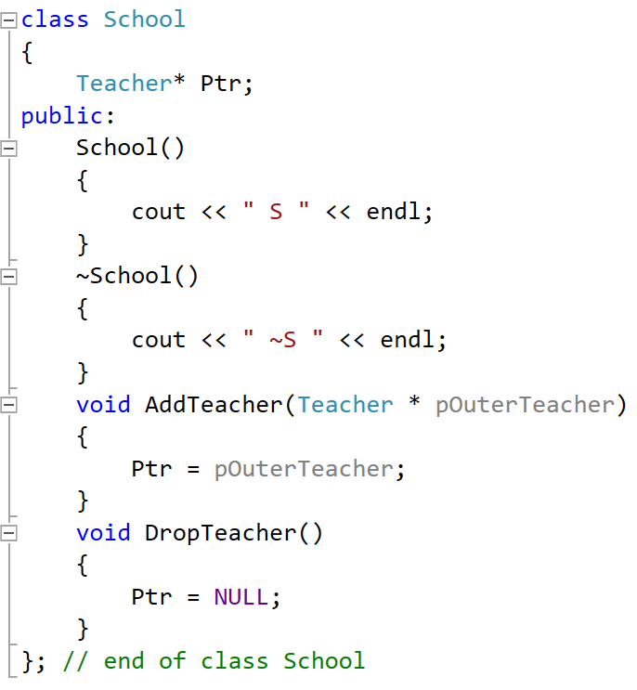
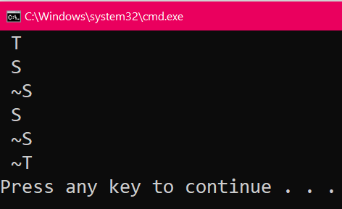
Association
School Objs
S2
T Ptr
Ptr
2
2
S1
Teacher Obj
T Ptr
1
T1
3
Ptr
id
1
Stack

Slide 10
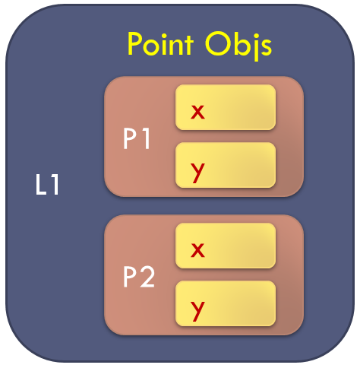
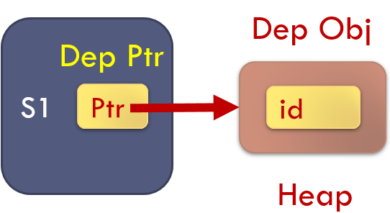
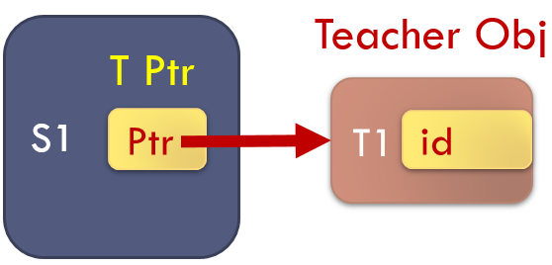
Composition
Aggregation
Association

Slide 11
Comparison
 | Composition | Aggregation | Association
Is the inner class object or pointer inside the outer? | Object | Pointer | Pointer
The construction of the inner class object is the responsibility of: | The Outer Class (Automatic/Static Alloc.) | The Outer Class (Dynamic Alloc.) | NOT the Outer Class (e.g., in the main func. Or a third class)
The destruction of the inner class object is the responsibility of: | The Outer Class (Automatic/Static De-alloc.) | Maybe the Outer Class Based on user requirement (Dynamic De-alloc.) | NOT the Outer Class (e.g., in the main func. Or a third class)
Lifetime of the outer and inner class object: | Totally Dependent | Dependent in construction, and maybe also in destruction | Totally Independent
How strong is the relationship? | Very Strong | Strong | Weak

Slide 12
Thank you

